Slide 1
Physics and Disability: Supporting the Variety of Peoples’ Needs, Abilities, and Interests
6/15/20
Link to slides: http://tiny.cc/fermi_disability
Jackie Chini (she/her) and Erin Scanlon (she/her)
University of Central Florida, Department of Physics
This work supported in part by NSF DUE 1612009 and NSF HRD 1750155.
Notes:
Both

Slide 2
Outline
Plan 45-50 minutes of content
Intro (25 min)
Introduction to disability (5 mins)
Models of disability (2 min)
Representation in STEM (5 min)
Audience question: What legal protection are you aware of? (2 mins)
Laws pertaining to disability (3 min)
Audience question: Ableism (5 min)
Description of ableism (3 min)
Supporting students with disabilities in the classroom (15 min)
Ability profiles (7-8 min)
UDL (7-8 min)
Supporting people with disabilities in the workforce (8 min)
DPCS
Call to action (2 min)

Slide 3
Poll: Who is here with us today?
Indicate your role/position using Zoom poll:
Student
Person with mainly teaching responsibilities
Person with mainly research responsibilities
Person with a mixture of teaching and research responsibilities
Staff member

Slide 4
Outline
Introduction to disability
Supporting students with disabilities in the classroom
Supporting people with disabilities in the workforce
Notes:
Jackie

Slide 5
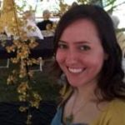
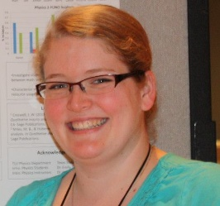
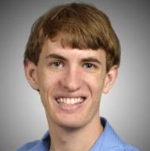
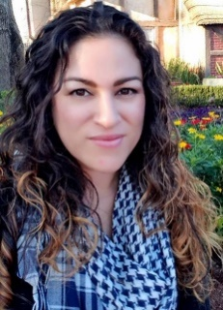
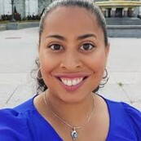
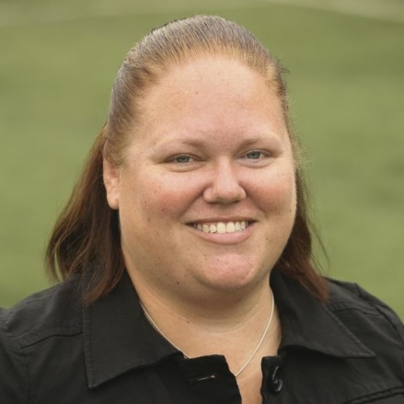
Our UCF Research Team
Postsecondary STEM Educators/Researchers
Experts in Exceptional Education
Jackie Chini,
Physics faculty
Kamryn Lamons,
Physics undergrad
Roberto Spilka,
Biomed. Sci. undergrad
Amanda Lannan,
Except. Ed grad
Trey Vasquez,
Except. Ed faculty
Erin Scanlon,
Physics Postdoc
Westley James,
Physics grad
Caroline Bustamante,
Health Sci. undergrad
Sacha Cartegena,
Except. Ex. grad
Jillian Schreffler,
Except. Ed grad
Notes:
Jackie

Slide 6
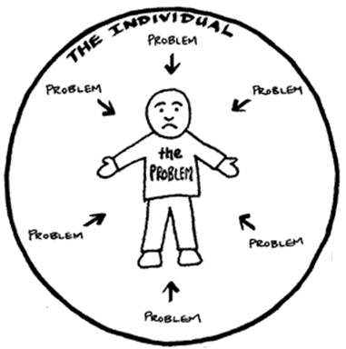
Two Prevalent Models of Disability¹
http://ddsg.org.uk/taxi/medical-model.html
http://ddsg.org.uk/taxi/social-model.html
¹ Goodley, 2017
Notes:
Erin

Slide 7
People with Disabilities:
Represent approximately 15% of world’s population¹
Comprise approximately 10-20% of the postsecondary student population (measured using different definitions of disability categories)^{2,3}
Enroll in science and engineering majors at similar rates as students without disabilities (28% and 27.6%)³
Workforce:
Comprise 9.3% of employed physical scientists³
Comprise 3.3% of employed life, physical, and social scientists⁴
Comprise 9.9% of federal civilian non-postal employees⁵
¹ WHO, 2015 ² Horn, Berktold, & Bobbitt, 1999 ³ NSF, 2019 ⁴ BLS, 2020 ⁵ OPM, 2017
Notes:
Erin

Slide 8
Changing Representation of Disability Diagnoses in Higher Education
NCES 1996, 2014 Scott, 2009
Notes:
Erin

Slide 9
What are the national and/or institutional protections for people with disabilities?
Jot down your thoughts.
Notes:
Jackie

Slide 10
Protections for People with Disabilities
Legal Protections¹
Americans with Disabilities Act
Rehabilitation Act
Telecommunications Act
Architectural Barriers Act
Fermilab Policies
“As a federal government contractor, the Laboratory also has the obligation to develop an affirmative action program for individuals with disabilities and protected veterans.”²
“Disruptive or harassing behavior shall not be tolerated regardless of race, color, religion, disability, age, gender, veteran status, sexual orientation, gender identity, and/or nationality.”³
¹ https://www.ada.gov/cguide.htm ² Fermilab HR, 2019 ³ Fermilab HR, 2017
Notes:
Jackie

Slide 11
However…
Postsecondary faculty lack awareness about and training to support students with disabilities¹⁻³
STEM curricula are not designed to support students with disabilities⁴⁻⁵
STEM professionals hold negative views about people with disabilities^{2,6}
¹ Scott, 2009 ² Norman et al., 1998 ³ Love et al., 2014 ^{4,5} Scanlon et al., 2018 a,b ⁶ Rao, 2004
Notes:
Jackie

Slide 12
Let’s talk about Ableism
Jot down your current ideas about ableism:
What is it?
What does it look like?
Where/when does it occur?
Notes:
Jackie

Slide 13
Describing Ableism¹⁻³
Discrimination or prejudice in favor of able-bodied people
Beliefs that able-bodied people:
are inherently superior to disabled people
possess essential qualities to participate in “normal” society
should be designed for; physically, culturally, and systemically
“everything we do is embedded in society, everything is political … physics is steeped in this tradition as well.”⁴
By default, people are ableist unless they are actively anti-ableist
¹ Dolmage, 2017 ² Wolbring, 2007 quoted in Goodley, 2014 ³ Baines, 2014 ⁴ Traxler & Blue, 2020
Notes:
Jackie

Slide 14
Examples of Ableism in STEM
Not using microphones at academic conferences
Not having elevator access to all levels of a large experiment
Requiring 14 hour days to fully participate and/or to meet deadlines
Notes:
Jackie

Slide 15
Supporting Students with Disabilities
Ability Profiles
Universal Design for Learning
Notes:
Erin

Slide 16
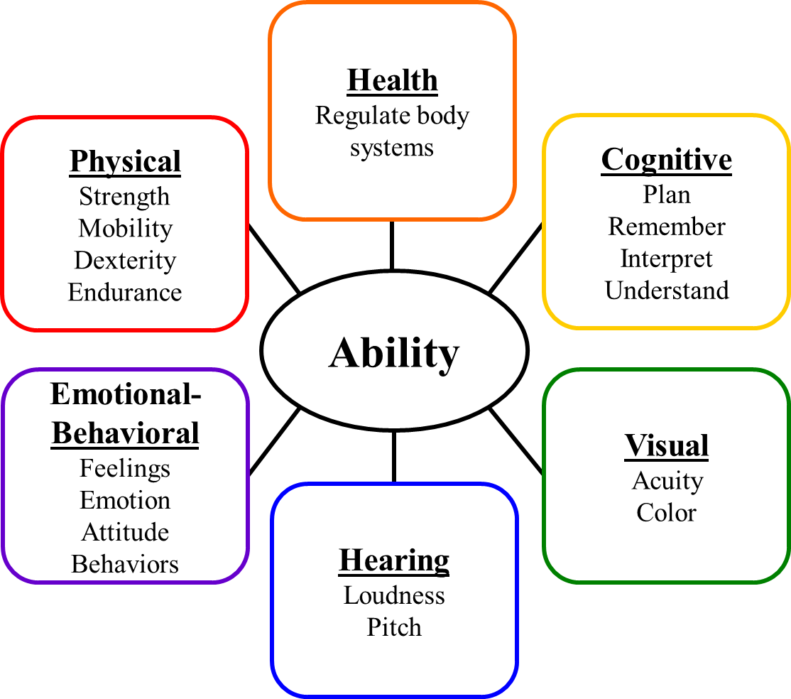
Ability Profiles Toy Model
Learner variation¹
People have abilities across a multidimensional spectrum
Abilities can vary:
Within a person across these dimensions
Between people along the same dimensions
Day to day
Across contexts
¹ Scanlon & Chini, 2018
Notes:
Erin

Slide 17
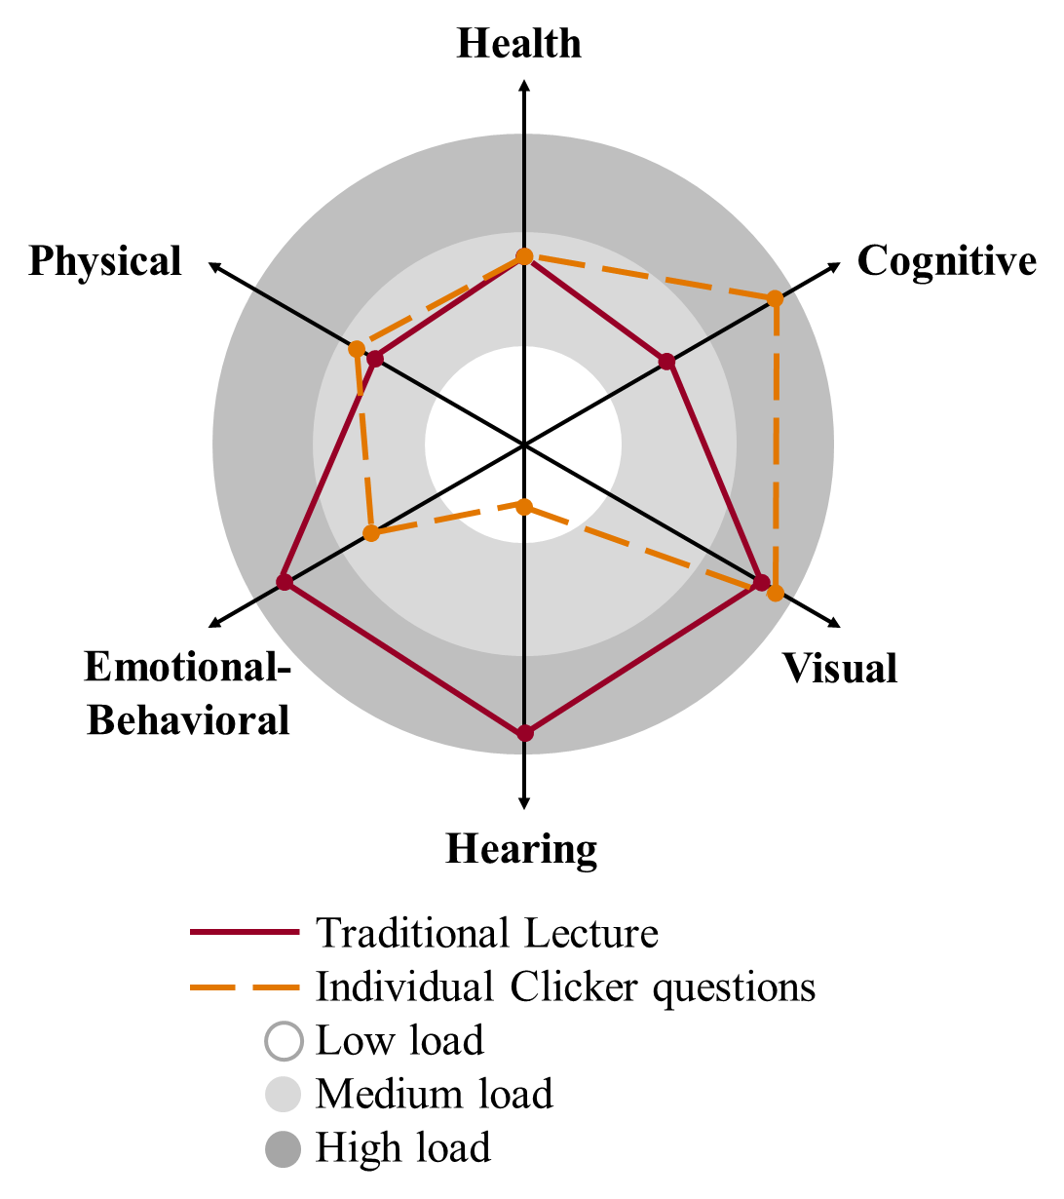
How do ability profiles affect physics teaching and lab design?
Scanlon & Chini, 2018
Notes:
Erin

Slide 18
Current Accommodations Model
A course is developed or lab is set up
Peron with a disability works with local office of disability services or human resources
Disability service office/human resources gives accommodation list to instructors/PI
Alterations are made to the course or lab
Repeat for every new accommodation list
Notes:
Jackie

Slide 19
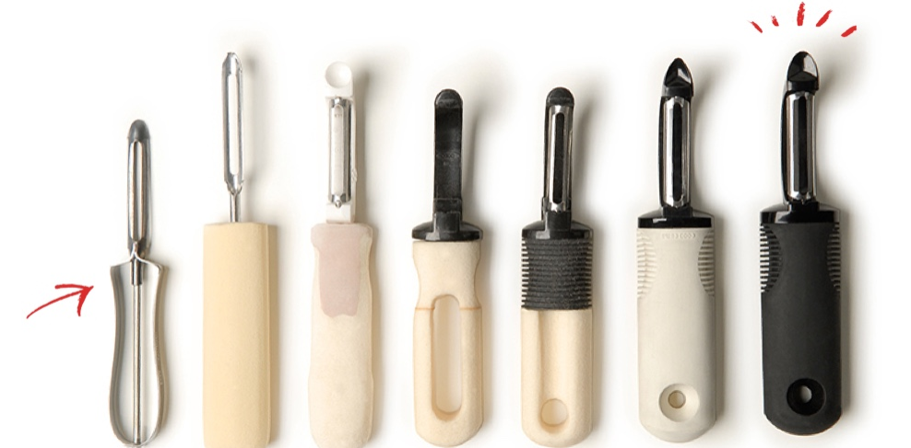
Universal Design of Products
Evolution of OXO peeler for increased accessibility and ease of use¹
¹ https://www.oxo.com/about
Notes:
Jackie

Slide 20
Universal Design for Learning (UDL)
If a shoe is designed based on the average shoe size, would it be effective for everyone?
Who would be the most negatively affected by this?
If curriculum and courses are designed for the “average” student, will they be effective for everyone?
UDL recognizes the variability of learners’ needs, abilities, and interests
Plans for this variability rather than the “average”
Notes:
Jackie

Slide 21
Universal Design for Learning Framework¹
Principle | Guideline – Provide options for: | # of Checkpoints
Provide Multiple Means of Representation | 1. perception | 3
 | 2. language, mathematical expressions, and symbols | 5
 | 3. comprehension | 4
Provide Multiple Means of Action and Expression | 4. physical action | 2
 | 5. expression and communication | 3
 | 6. executive function | 4
Provide Multiple Means of Engagement | 7. recruiting interest | 3
 | 8. sustaining effort and persistence | 4
 | 9. self-regulation | 3
http://udlguidelines.cast.org/
¹ CAST, 2011
Notes:
Jackie

Slide 22
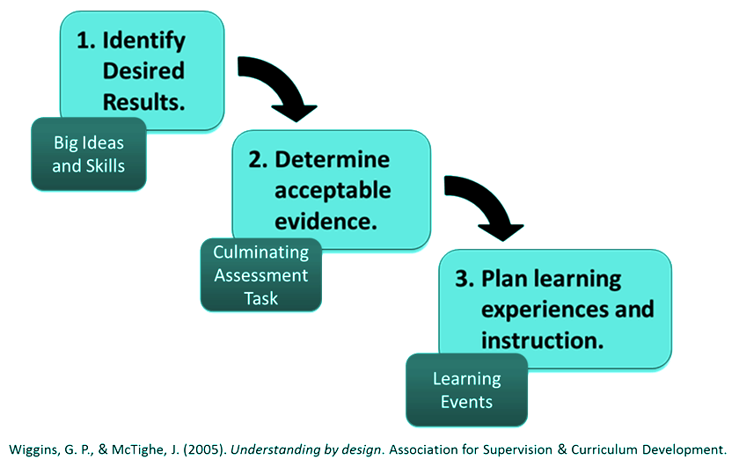
Backwards Design with UDL¹
START HERE
Space for UDL
¹ Wiggens & McTighe, 2005

Slide 23
UDL Resources
Starting with UDL:
http://dsq-sds.org/article/view/4632/3946
https://quod.lib.umich.edu/u/ump/mpub9708722
UDL Examples:
http://udloncampus.cast.org/home
Seminal research paper about UDL:
Rose, D. H., & Meyer, A. (2002). Teaching Every Student in the Digital Age: Universal Design for Learning. Association for Supervision and Curriculum Development, 1703 N.
TED talk about UDL:
https://www.youtube.com/watch?v=4eBmyttcfU4

Slide 24
Supporting Students with ADHD¹
Worked with a health sciences major who wanted to share her experiences as a student with ADHD in introductory physics courses
Things she wants physics instructors to know:
Instructors should initiate open dialogue about students’ needs, abilities, and interests
Scaffold the course content to help students stay on track
Provide course resources in multiple formats to allow for options in how and when students learn content
Demonstrate understanding that accommodations promote equity in the class
¹ Bustamante, Scanlon, & Chini, https://arxiv.org/abs/1907.12448

Slide 25
Inclusive Teaching Strategies
Multiple means of engagement
Choose activities that optimize the relevance of curriculum to students’ lives
Provide and encourage mastery-oriented feedback
Provide models and feedback for managing frustration
Multiple means of representation
Provide digital copies of course materials
Define vocabulary or symbols
Remind students of previously covered concepts or equations or referring to previous activities
Multiple means of action and expression
Allow students to respond to questions in formats other than writing
Request students to show their understanding in a myriad of media such as text, speech, etc.
Provide templates for data collection and organization of information

Slide 26
Supporting people with disabilities in the workforce
Attitudes and Beliefs of Practicing Physicists
Notes:
Jackie

Slide 27
Guiding Questions
What assumptions do physicists hold that limit possibilities for participation by the widest range of individuals?
What does a physicist have to be able to do?
What do physics mentors know and believe about disability/impairment?
Notes:
Jackie

Slide 28
Our Study
Investigating practicing physicists’:
Knowledge about disability diagnoses
Beliefs about the viability of physics careers for people with a range of disabilities
208 participants completed the survey
Recruited through APS meetings and physics listservs
Participants include:
Faculty (28%), students (50%) and others (22%) including industry, government worker, and high school teachers
People with disabilities (22%), who taught students with disabilities (51%), and who have a family/friend with a disability (47%)
Notes:
Erin

Slide 29
Physicists’ Knowledge about Disability
Place diagnoses into appropriate category of impairment
Hearing
Visual
Learning/Reading
Cognitive
Which category of impairment do the following diagnoses belong in?
Color blindness
Attention deficit/hyperactivity disorder (ADHD)
Depression
Migraines
Health
Physical
Mobility
Emotional/Mental Health
Notes:
Erin

Slide 30
Physicists’ Knowledge about Disability
Place diagnoses into appropriate category of impairment
Commonly Correct:
Hearing
Visual
Emotional/Mental Health
Commonly Incorrect:
Learning/Reading
Cognitive
Health
Physical
Mobility
Notes:
Erin

Slide 31
Beliefs about the Viability of Physics Careers
Participants identified physics careers that are viable for people with different types of impairments
Viable career responses varied by impairment:
Cognitive impairments had the lowest number of viable career responses
Physics professor was less commonly rated as viable for cognitive and emotional/mental health impairments
Theoretical researcher was less commonly rated as viable for learning/reading, cognitive, and emotional/mental health impairments
Notes:
Erin

Slide 32
Role of Mentors in Supporting People with Disabilities
“Students have trouble finding mentors with disabilities. They must contend with widespread ignorance, not only about their specific disabilities (whether visible or invisible) but about the Americans with Disabilities Act… When they finish their studies, people with disabilities are more likely to pursue STEM careers in the government and less likely than others to go into education. This has implications for visibility, as students are unlikely to know any disabled STEM teachers…”¹
¹ Traxler & Blue, 2020
Notes:
Jackie

Slide 33
“Ability, like race, is a social construct. The experts are those in power, and their knowledge about not only STEM but about who is able to do STEM comes from them—so they remain in power.”¹
¹ Traxler & Blue, 2020
Notes:
Jackie

Slide 34
Who we are prepared to teach and support in the physics community expresses our expectations of who will participate
If you don’t build it, they won’t come
Notes:
Erin

Slide 35
Who we are prepared to teach and support in the physics community expresses our expectations of who will participate
People with disabilities are in physics and we aren’t supporting them!
Notes:
Erin

Slide 36
Thank you for your attention!
These slides: http://tiny.cc/fermi_disability
Chini group’s relevant papers: tiny.cc/Disability_Papers
Our language document: tinyurl.com/ucfperdisabilitylanguage
Contact us: Jchini@ucf.edu or Erin.Scanlon@ucf.edu
Notes:
Both

Slide 37
References - 1
D. Goodley, Disability Studies: An Interdisciplinary Approach, 2nd ed. (Sage Publications, London, 2017).
World Health Organization (2015). WHO global disability action plan 2014-2021: Better health for all people with disability. http://www.who.int/disabilities/actionplan/
L. Horn, J. Berktold, & L. Bobbitt, Postsecondary education descriptive analysis reports: Students with disabilities in postsecondary education: A profile of preparation, participation, and outcomes (Washington, DC: US Department of Education, 1999). https://nces.ed.gov/pubs99/1999187.pdf
National Science Foundation, National Center for Science and Engineering Statistics, Women, Minorities, and Persons with Disabilities in Science and Engineering: 2019. Special Report NSF 19-304, (2019). https://ncses.nsf.gov/pubs/nsf19304/
U.S. Bureau of Labor Statistics (2020). Persons with a disability: Labor force characteristics – 2019. https://www.bls.gov/news.release/pdf/disabl.pdf

Slide 38
References - 2
U.S. Office of Personnel Management (2017). Profile of Federal Civilian Non-Postal Employees. https://www.opm.gov/policy-data-oversight/data-analysis-documentation/federal-employment-reports/reports-publications/profile-of-federal-civilian-non-postal-employees/
National Center for Education Statistics. (1996). 1995-96 national postsecondary student aid study (NPSAS:96), undergraduate data analysis system. Washington, DC: U.S. Department of Education.
National Center for Education Statistics. (2014). Profile of undergraduate students: 2011–2012 (No. NCES 2014–167). Washington, DC: U.S. Department of Education. https://nces.ed.gov/pubs2015/2015167.pdf
G. A. Scott, Higher education and disability: Education needs a coordinated approach to improve its assistance to schools in supporting students. Government Accountability Office, 10(33), 1-51 (2009).
https://www.ada.gov/cguide.htm

Slide 39
References - 3
Fermilab (2015). Affirmative Action Program. https://diversity.fnal.gov/wp-content/uploads/2019/10/affirmativeaction.pdf
Fermilab (2017). Statement of Community Standards. https://directorate-docdb.fnal.gov/cgi-bin/RetrieveFile?docid=174
K. Norman, D. Caseau, & G. P. Stefanich, Teaching students with disabilities in inclusive science classrooms: Survey results. Science Education, 82(2), 127-146 (1998).
T. Love, N. Kreiser, E. Camargo, M. Grubbs, E. Kim, P. Burge, & S. Culver, STEM Faculty experiences with students with disabilities at a Land Grant Institution. Journal of Education and Training Studies, 3(1), 27-38 (2014).
E. Scanlon, J. Schreffler, W. James, E. Vasquez, and J. J. Chini, Postsecondary physics curricula and Universal Design for Learning: Planning for diverse learners, Phys. Rev. Phys. Ed. Res. 14, 020101 (2018).

Slide 40
References - 4
E. Scanlon, T. Legron-Rodriguez, J. Schreffler, E. Ibadlit, E. Vasquez, & J. J. Chini, Postsecondary chemistry curricula and Universal Design for Learning: Planning for variations in learners’ abilities, needs, and interests, Chemistry Education Research and Practice 19, 1216 (2018).
S. Rao, Faculty attitudes and students with disabilities in higher education: A literature review, College of Student Journal 38 (2004).
J. T. Dolmage, Academic Ableism: Disability and Higher Education (University of Michigan Press, Ann Arbor, 2017). Retrieved from www.press.umich.edu/9708836/academic_ableism
G. Wolbring (2007), quoted in D. Goodley, Dis/ability Studies Theorising disablism and ableism, Routledge (2014). https://doi.org/10.4324/9780203366974
A.D. Baines, (Un)Learning Disability: Recognizing and Changing Restrictive Views of Student Ability, Teachers College Press (2014).

Slide 41
References - 5
A. Traxler, & J. Blue (2020). Disability in Physics: Learning from Binary Mistakes. https://link.springer.com/chapter/10.1007/978-3-030-41933-2_8
E. M. Scanlon and J. J. Chini, Ability Profiles: A Framework for Conceptualizing Dimensions of Ability, 2018 PERC Proceedings [Washington, DC, August 1-2, 2018], edited by A. Traxler, Y. Cao, and S. Wolf, DOI: https://doi.org/10.1119/perc.2018.pr.Scanlon
https://www.oxo.com/about
CAST (2011). Universal Design for Learning Guidelines version 2.0. Wakefield, MA: Author.

Slide 42
Abstract
All people inherently vary in terms of their needs, abilities, and interests. However, previous research indicated that physicists receive little training about supporting people with disabilities, physics curricular materials are not designed to support students with disabilities, and STEM professionals hold more negative views about people with disabilities than their peers in other academic disciplines. In this talk, we will discuss ableism in the academy and STEM community, theories of disability, disability in physics, and mechanisms, tools, and considerations to plan for variation in peoples’ needs, abilities, and interests.

