Slide 1
Curious about being a Faculty member at a four-year college
Drew Alton
Augustana University

Slide 2
Outline
A bit on why
A bit about myself
What is different about a primarily undergraduate institution(PUI)
What is different about the job search for a PUI

Slide 3
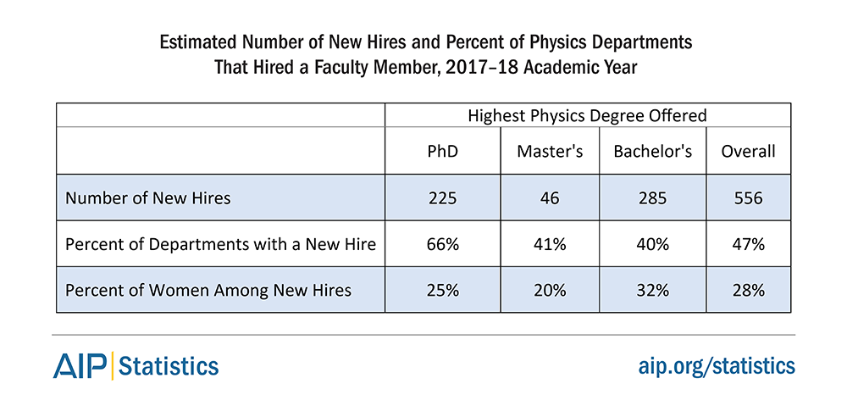
Some AIP stats

Slide 4
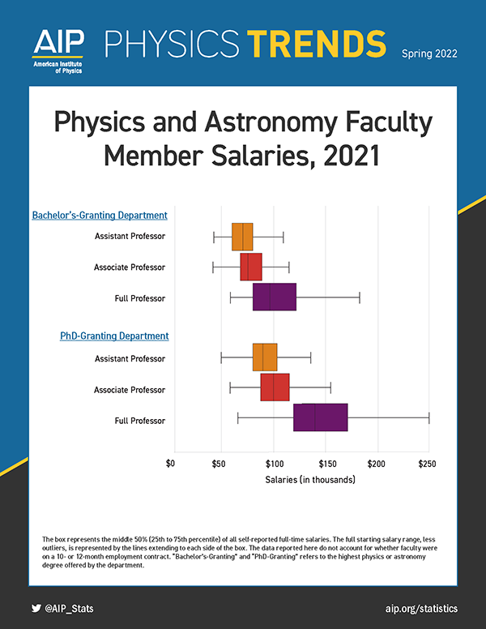
Need to be aware of this
These jobs won’t pay as well as an R1 university.
I’ve had a student who was just about to graduate and excited about taking a job tell me his salary. It was about $10k more than my salary at the time.
When I took this job I had an offer from BoA for twice my 9 month salary.

Slide 5
Industry or academia? How to choose your path
May have seen this article earlier this month by Joanne Zajac
https://physicsworld.com/a/industry-or-academia-how-to-choose-your-path/
She suggests these four major differences:
Working style (Team vs solo, industry being team)
Management (Academic being mostly self directed)
Work-life balance (Industry having more of a home life)
Actual tasks involved (industry being more product oriented)
Academics at a PUI has more freedom on this, and the work-life balance is definitely more under your control.

Slide 6
My Education and Research
BS in physics with math minor from University of Iowa (1992)
An REU at U of Notre Dame in superconductivity
Two years off to “find myself”
MS from Ball State University (1996)
Thesis on FNAL E683– Fixed target Photon-Nucleus scattering
PhD from Kansas State Univeristy (2000)
Thesis on NuTeV. Neutrino production of charm.
Postdoc University of Michigan (2000-2006)
DØ worked on Fiber Tracker and Diboson physics
Professor (Assistant 2006-2012, Associate 2012-2020, Full 2020-
Continued D0, Added DarkSide, and a couple years ago joined DUNE

Slide 7
Why do I like this?
For me the biggest draw is the personal relationship with the students!
If you went to an R1 institution as an undergrad you may never have seen this.
I have most physics majors in at least three classes before they graduate
I have students who graduated 12 years ago that still reach out and let me know how they are.
I had a student who was only in my Physics I and II class send me an email 10 years later telling me how I had changed her life. She graduated with plans of med school and now has a PhD in Geophysics. She’s the most dramatic example, but I have been told something like this by many students.

Slide 8
So what is a primarily undergraduate institution like?
Much more teaching.
A lot more variety in what the institution expects
It offers more freedom on things like location
It won’t pay as well
Research funding won’t be as plentiful but can be just as available.

Slide 9
Teaching Load
Not like an R1, where you can go semesters or years without teaching (except sabbatical)
Teaching load at my school is suppose to be 3-1-3, but labs reduce that. Typically I teach 2.3-1/2-1.5
When looking one job I phone-interviewed for had a load of 4-4.
I decided that was too much.
Very likely that you will teach across the physics curriculum but also you’re likely to need to teach outside the physics curriculum
Lab science for non-majors
First year seminar
Capstone, honors program, etc

Slide 10
My teaching this year
Fall
Physics 1-calc based 3 hrs lecture and two-2 hour labs total of 30-40 students
Computational Physics—Survey of Calc 3, DE, linear Algebra and Matlab 3 hours, 5-10 students
Co-teach Intermediate Lab, 3-7 students
January
Electronics for Scientists and Engineers, 3 hours lecture, 3 hours lab each day, 10 students…I love this class but hate teaching it in January
Spring
Analytical Mechanics (Junior level) 3 hours lecture, 9 students
Teaching release from a grant
Co-teach Advanced Lab, 3-7 students

Slide 11
Variety in what they expect
See the teaching load
Research
Some places don’t expect any at all, some places like Augustana expect research during the summer but “almost nothing” during the school year
Advising
It’s very likely you’ll advise students who are physics majors
May need to advise students who are undecided/exploring
Committee duties
Standing committees like curriculum council, task forces on revamping Gen Ed, etc

Slide 12
Location
When I applied for R1 institutions, I applied to places in England, Canada, across the USA
For the PUI, I only applied within about a 7 hour drive of mine and my wife’s home towns.
Most R1 institutions were looking in a specific specialty and if it was particle physics they had a specific subspecialty in mine and possibly a specific experiment (Particle physics, neutrino physics or collider physics…even CMS not Atlas)
Most PUIs are looking for someone with teaching experience, they want you to at least pretend you’ll do some research but that means basically if they’re in your chosen geography you have a chance

Slide 13
Research Funding
Research Corporation for Scientific Advancement has grants for physics professors in their first 3 years and at PUI.
NSF has programs specifically for PUI. All the tenure/tenure track faculty at AU have NSF funding. This is unusual but I think it’s because we can help each other that it’s worked for us.
Some states are EPSCoR states, these are states which don’t get very much federal research funding, and thus they have a pipeline to money only for them.
I chose South Dakota because of plans for DUSEL which has become SURF.
My institution also has internal grants. The first two years, I got those to support me getting my program started. They were $7000.
So it’s possible to get some money. The NSF grants have been $20,000/year up to $70,000 a year. You (probably) won’t have a post-doc but you can support a few undergrads and a month or two of summer salary and a little travel

Slide 14
Job Search
Where you apply is different as mentioned
How you apply is also different
How the interview goes is going to be different
….. Before all of that
What experience they want you to have is different

Slide 15
What to do before you start to apply
Any teaching experience
I knew I wanted the teach…my original plan for my BS was a high school teacher
So I helped teach a high school class of 5
Anything you do beyond “I taught a lab class my first two years of grad school” will help.
Tutor (Mathnasium, Varsity Tutors, etc) you’ll make a bit of money but it also separates you from everyone else
If you can adjunct a class at a local college it’ll be even stronger.
Undergraduate Mentor
If you want to go somewhere that research is even slightly relevant get some experience mentoring an undergraduate in research.
During my MS, I got to do this once
During my PhD I helped with one and got to be the primary mentor of another
During my Post-doc I had another

Slide 16
Where to apply
First, where to find jobs
Don’t bother with the particle physics rumor mill or Insprire hep jobs
APS job site https://www.aps.org/careers/employment/index.cfm and physics today are good options. Most physics departments will advertise there.
The Chronicle is another option https://jobs.chronicle.com/ . Sometimes deans don’t listen to the department on where to advertise.
I grew up in Iowa, that was my goal location, I found all the schools in the state with a BA/BS in physics and found the Human Resources page of them and bookmarked them.

Slide 17
The Application
Make “contact” before you apply
Find the department website
How many faculty are there? Does it look like they are really doing research? Can you get an idea of teaching load?
If the add mentioned contacting someone and they are in the department, it might be worth a phone call/email. It might allow you to customize your material to their job.
What you send typically
Cover letter, CV
Research statement—maybe or maybe it’s in cover letter
Teaching statement– This is probably new

Slide 18
Do NOT send generic stuff
DO NOT send the Research statement you wrote for Michigan State
They know you can’t do the same things. High light that you have experience advising undergraduates in research
In the teaching statement, highlight any experience you have
If you aren’t familiar with active learning, find out about it, don’t claim to be an expert at it, but show them you’ve done some homework and tell them what you want to try.
It might be worth mentioning that the AAPT has a “New Faculty Workshop” and you’d like to do that once you are a new faculty (It’s a great experience!!)
Do not screw up the “Dear Dean Fredrick”
Keep in mind that almost certainly a non-physicist is reading these applications.

Slide 19
The Interview
Often there are phone interviews (probably Zoom now) before an on-site interview. This is because smaller schools don’t have the money to bring out 5 candidates.
I found someone I knew at a small school and did a practice phone interview.
On a phone interview feel free to ask how many people they are interviewing on the phone and how many they’ll bring out for on-site interviews. Asking about the timeline is fine, let them know that you realize things might slip.
For two of my interviews I was the only candidate they were going to bring to campus (It was mine to loose).
Small places are more likely to try in the fall. When we did we hoped to interview in the fall and have an offer out by Christmas.

Slide 20
Questions
Ask now…
Ask later drew.alton@augie.edu
After you get

